Slide 1
Introduction to Cryptography
( --Foundation of information security--)
By:
Arun Mishra

Slide 2
Acknowledgement:
“Cryptography & Network Security” by William Stallings, Pearson Education Asia.
Kahate A, “Cryptography & Network Security”, Tata McGraw Hill, 2004.
Reference Books
“Applied Cryptology” by Schiner Bruce, John Wiley & Sons, 2001.
“Introduction to Cryptography with Coding Theory” by Wade Trappe & Lawrence CWashington, New Jersey, Pearson Education, 2006.
Charlie Kaufman, Radia Perlman and Mike Speciner, “Network Security: PrivateCommunication in a Public World”, Prentice Hall of India Private Limited.
Behrouz A. Forouzan, “Cryptography and Network Security”, McGraw Hill

Slide 3
Marking
Internal Test– 30
Lab Assigenments-20
END SEM - 50

Slide 4
Why study cryptography?

Slide 5
A
B
Intruder
Communications security

Slide 6
Definitions
Computer Security - generic name for the collection of tools designed to protect data and to thwart hackers
Network Security - measures to protect data during their transmission
Internet Security - measures to protect data during their transmission over a collection of interconnected networks

Slide 7
Who is the Opponent
Computer/ Machine
Person
Application/ Process/Program

Slide 8
The Basic Problem
We consider the confidentiality goal:
  Alice and Bob are Friends
  Eve is a rival
  Alice wants to send secret messages (M₁,M₂,…) to Bob over the Internet
  Rival Eve wants to read the messages (M₁,M₂,…) - Alice and Bob want to prevent this!
  Assumption: The network is OPEN: Eve is able to eavesdrop and read all data sent from Alice to Bob.
  Consequence: Alice must not send messages (M₁,M₂,…) directly – they must be “scrambled” or encrypted using a ‘secret code’ unknown to Eve but known to Bob.

Slide 9
The General Goals of Cryptography
Confidentiality; assuring that only authorized parties are able to understand the data.
Integrity; ensuring that when a message is sent over a network, the message that arrives is the same as the message that was originally sent.

Slide 10
Technical solutions include:
Encryption
Hashing algorithms

Slide 11
Goals (cont.)
Authentication; ensuring that whoever supplies or accesses sensitive data is an authorized party.
Nonrepudiation; ensuring that the intended recipient actually received the message & ensuring that the sender actually sent the message.

Slide 12
Technical solutions include:
Passwords
Digital signatures

Slide 13
Security Threats and Attacks
A threat is a potential violation of security.
  Flaws in design, implementation, and operation.
An attack is any action that violates security.
Note: Router mis-configuration or server crash can also cause loss of availability, but they are not attacks

Slide 14
Security Attack
Two generic types of attacks
  Passive
  Active

Slide 15

Passive Attacks

Slide 16
Example
  The Release of message contents
  Traffic Analysis

Slide 17

Active Attacks

Slide 18
Example
  Masquerade
  Replay
  Modification of messages
  Denial of service

Slide 19
Continue….

Slide 20
Private key cipher
Encryption
Encrypted message
(ciphertext)
Decryption
Encrypted message
(ciphertext)
E
Alice
D
Bob
key
Message
(cleartext,plaintext)
Message
(cleartext, plaintext)

Slide 21
Basic Terms
Encryption: scrambling a message or data using a specialized cryptographic algorithm.
Plaintext: the message or data before it gets encrypted.
Ciphertext: the encrypted (scrambled) version of the message.
Cipher: the algorithm that does the encryption

Slide 22
Classical Ciphers
Plaintext is viewed as a sequence of elements (e.g., bits or characters)
Substitution cipher: replacing each element of the plaintext with another element.
Transposition (or permutation) cipher: rearranging the order of the elements of the plaintext.
Product cipher: using multiple stages of substitutions and transpositions

Slide 23
Basic Terms (cont.)
Decryption: the process of converting ciphertext back to the original plaintext.
Cryptanalysis: the science of breaking cryptographic codes/algorithms.
Cryptanalyst: a person who breaks cryptographic codes; also referred to as “the attacker”.

Slide 24
Types of ciphers
Private key cryptosystems/ciphers
  The secret key is shared between two parties
Public key cryptosystems/ciphers
  The secret key is not shared and two parties can still communicate using their public keys

Slide 25
Contd..
Encryption
Encrypted message
(ciphertext)
Decryption
Encrypted message
(ciphertext)
E
Alice
D
Bob
key
Message
(cleartext,plaintext)
Message
(cleartext, plaintext)

Slide 26
Concepts
A private key cipher is composed of two algorithms
  encryption algorithm E
  decryption algorithm D
The same key K is used for encryption & decryption
K has to be distributed beforehand

Slide 27
Notations
Encrypt a plaintext P using a key K & an encryption algorithm E
C = E(K,P)
Decrypt a ciphertext C using the same key K and the matching decryption algorithm D
P = D(K,C)
Note: P = D(K,C) = D(K, E(K,P))
CSE2500 System Security and Privacy

Slide 28
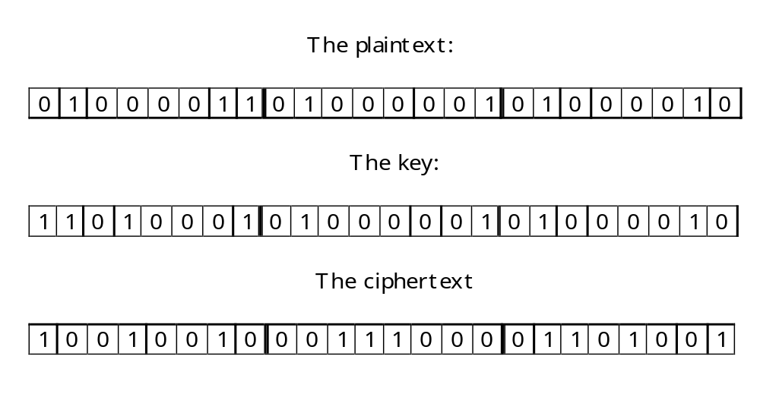
A Simple Example

Slide 29
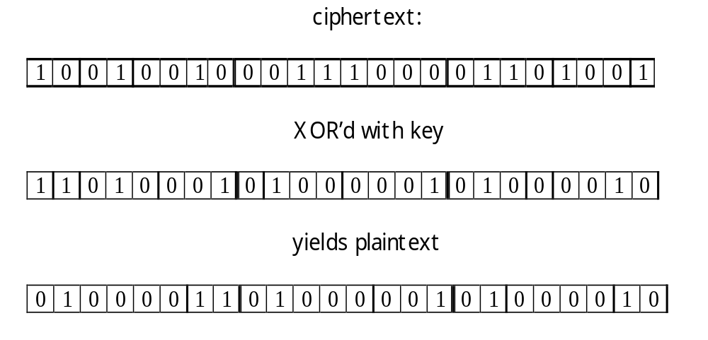
Example Contd..

Slide 30
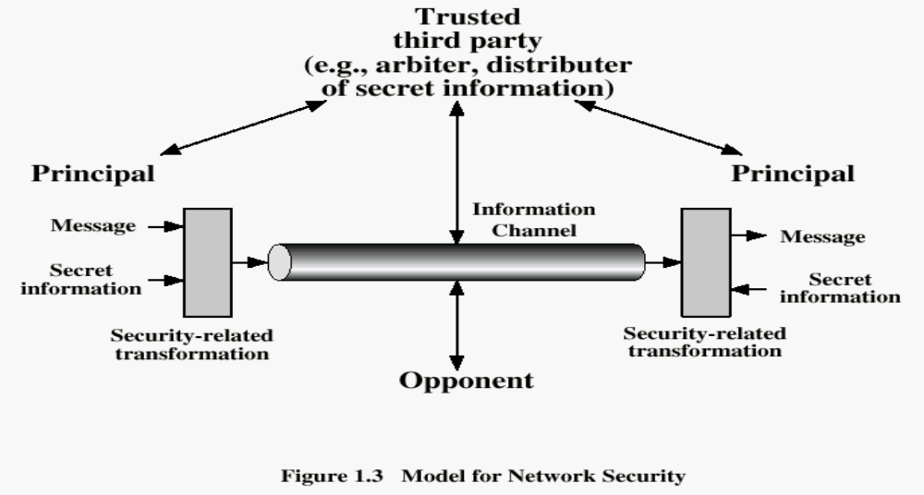
Model for Network Security

Slide 31
Model Contd..
Using this model requires us to:
  Design a suitable algorithm for the security transformation
  Generate the secret information (keys) used by the algorithm
  Develop methods to distribute and share the secret information
  Specify a protocol enabling the principals to use the transformation and secret information for a security service

Slide 32
Requirements
Characterize cryptographic system by:
  Type of encryption operations used
    substitution / transposition
  Number of keys used
    single-key or private / two-key or public
  Way in which plaintext is processed
    Block (typically 64 or 128 bits) / stream (1 bit)
Notes:
Cryptographic systems can be characterized along these three independent dimensions.

Slide 33
Cryptanalysis
Objective to recover key not just message
General approaches:
  Cryptanalytic attack
  Brute-force attack

Slide 34
Brute Force Attack
Always possible to simply try every key
Example:
Key Size (bits) 32 bits,
Number of Alternative Keys = 2³² = 4.3 × 10⁹
at 1 decryption / micro second
( Time required depends on kind of processing power)

Slide 35
Common Types of Cryptanalytic Attacks
Known cipher attacks: the attacker has the ciphertext and she tries to decrypt the message by generating all possible keys.
  Rarely successful because the number of possible keys is enormous.

Slide 36
Attacks Contd..
Known plaintext attack: the attacker has both the ciphertext and the plaintext.
  Again, this is difficult because there are so many keys, but the plaintext information may make experimentation easier than in the previous case.
  We are assuming that the attacker knows the algorithm that was used for the encryption.

Slide 37
Attacks Contd..
Chosen plaintext attacks: The cryptanalyst introduces the plaintext into the system and then watches for how that plaintext will be encrypted.
  The Allies used this approach by sending out false messages about allied troop movements.

Slide 38
Example: chosen-plaintext attack
In 1942, US Navy cryptanalysts discovered that Japan was planning an attack on “AF”.
They believed that “AF” means Midway island.
Pentagon didn’t think so.
US forces in Midway sent a plain message that their freshwater supplies were low.
Shortly, US intercepted a Japanese ciphertext saying that “AF” was low on water.
This proved that “AF” is Midway.

Slide 39
Chosen-ciphertext attack
Eve choose some ciphertext and decrypts it to form a ciphertext/plaintext pair.

Slide 40
Contd..
Side channel attacks use seemingly incidental information that can reveal important information about the key being used.
Attacker analyzes the power output from a processor performing an encryption algorithm in order to get information about the key being used by that algorithm.

Slide 41
More Definitions
Unconditional security
  No matter how much computer power or time is available, the cipher cannot be broken since the ciphertext provides insufficient information to uniquely determine the corresponding plaintext
Computational security
  Given limited computing resources (eg time needed for calculations is greater than age of universe), the cipher cannot be broken

